Slide 1

IT Essentials (CompTIA A+) Ch. 26
Care and Feeding of Mobile Devices

Slide 2
Overview
In this chapter, you will learn how to:
Troubleshoot common mobile device and application issues
Explain basic mobile device security
Describe typical mobile OS and application security issues
Notes:
2

Slide 3
Troubleshooting Mobile Devices
Mobile device hardware typically can’t be repaired or replaced by a field tech.
Device troubleshooting focuses on ruling out software issues.
If troubleshooting doesn’t fix the problem or identify a problem you can fix, may need to take device to authorized service center.
Exact steps depend on specific device, operating system, and OS version.
Notes:
Most of these tools either are guaranteed to erase data and customizations or have some risk of doing so under the right circumstances. Remember to communicate what steps you’ll be taking with the device’s user, including what kinds of data loss it can entail, and give them a chance to back up their data.

Slide 4
Check and Adjust Configuration/Settings
Modern mobile operating systems have many configurable settings.
Try a reboot first and then look at settings.
Keep track of what you change.
Record the previous setting.
Notes:
When closing an app, keep in mind that the user may lose unsaved data when you close it, and (depending on the app) that their device may lose certain functionality they expect it to have until the app is restarted.

Slide 5
Close Running Apps
Swipe the app in a particular direction from the list of recent apps.
May need to close an app if it has frozen or you suspect it is causing problems.
Some mobile OSs allow closing all open apps at once.
Some OSs may leave background processes running after apps are closed.
In Android, force stop will close app and its background processes.

Slide 6
Soft Reset
Soft reset describes restarting a device.
Initiated from the OS or with hardware buttons on the device
Removing the back cover and the battery will force a device with a removable battery to power down.

Slide 7
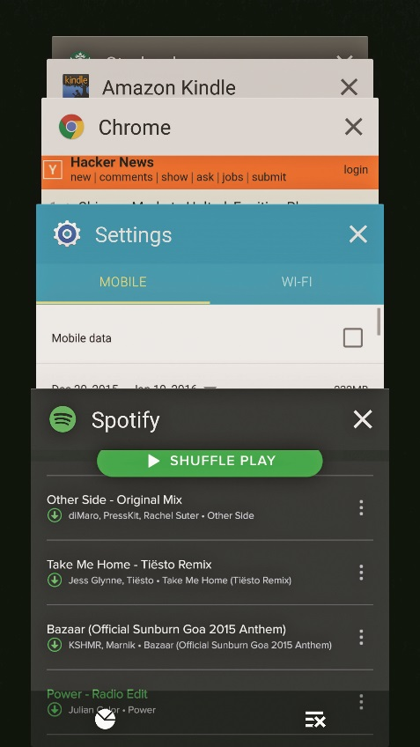
Soft Reset
Figure 26.1 The Overview Screen on Android 5.1 with a button to close all running apps

Slide 8
Uninstall/Reinstall apps
Uninstall or reinstall through app store or device’s application manager.
Jot down important settings and back up data before uninstalling.
App that had been working fine and suddenly begins having problems may have had a bad update.

Slide 9
Reset to Factory Default
Hard reset, factory reset, or reset to factory default:
Clears all user data and settings
Returns software to state when it left the factory
Back up all user data before performing a hard reset:
Unless device will be sold, recycled, or assigned to a new user
If issues are fixed, but then reappear after factory reset, revisit troubleshooting steps.

Slide 10
Touchscreen and Display Issues
Dim display
Check brightness control in the display settings.
Can be set to auto mode or controlled manually
Auto-adjustment are affected by detected light level.
If manually changing brightness doesn’t result in a range of brightness levels, the device might have a faulty display panel.
Reading apps like Amazon Kindle can interfere with system’s auto-brightness.
Soft reset will typically fix this issue.

Slide 11
Touchscreen and Display Issues
Touchscreen responsiveness
First, rule out dirt, accidental touch, and performance issues.
Wipe down touchscreen with dry microfiber cloth.
Show users how to avoid accidental touch.
Look for signs that the device is struggling to keep up and perform a soft reset.
Next, check calibration and diagnostics
Search online for information about hidden diagnostics menu or service menu.

Slide 12
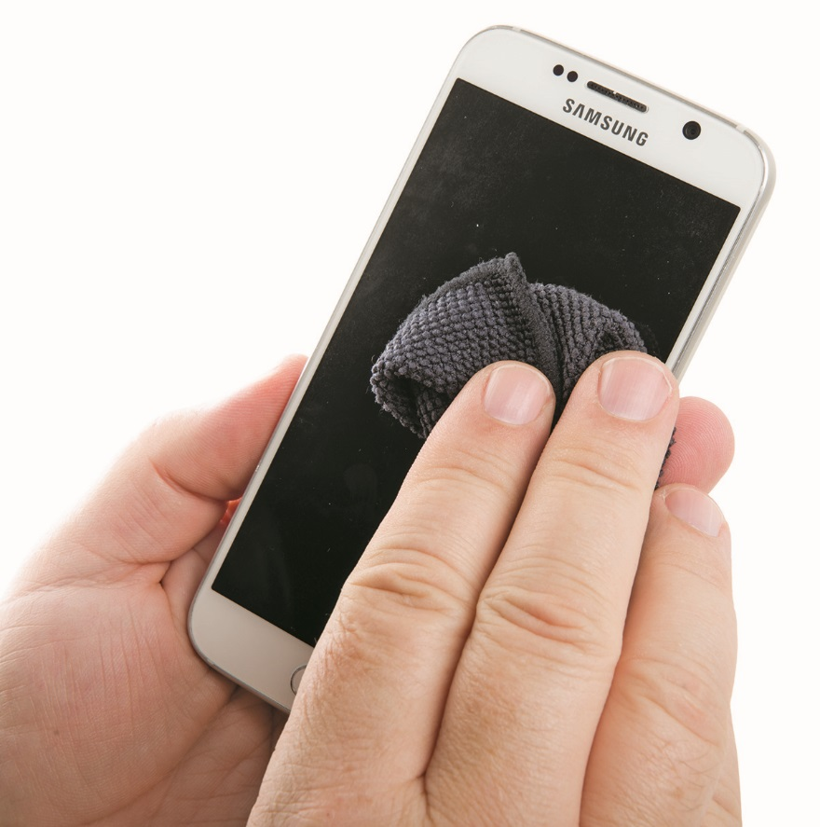
Touchscreen and Display Issues
Figure 26.2 Cleaning a smartphone

Slide 13
Touchscreen and Display Issues
Physical damage
Liquid can kill or damage the device.
Take the battery out immediately to try to prevent damage.
Completely dry the device before reinstalling the battery.
Drops or impacts can break internal connections.
Liquid contact indicator (LCI) stickers change color when exposed to water.
Often one on the battery or in battery compartment

Slide 14
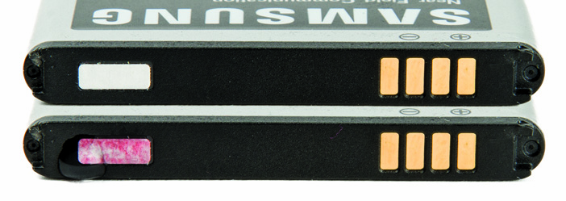
Touchscreen and Display Issues
Figure 26.3 Pristine LCI sticker (top) and LCI sticker absorbing a drop of water (bottom)

Slide 15
App Not Loading
Reasons a mobile device app may not load or install correctly
Incompatibility with device’s OS version or vendor/carrier OS customizations
Incompatibility with hardware
RAM, storage space, or processor type
Sensor or capabilities camera doesn’t support
Notes:
This section details reasons an app may always fail to load or install correctly. Remember, an app may fail to install or load correctly before you perform a soft reset, but do fine afterward. Perform a soft reset and then try loading or reinstalling the app .

Slide 16
Overheating
Factors that affect overheating:
Amount of heat produced by the mobile device
Heat added to the device by an external source such as the sun or a lamp
How well the device dissipates or retains heat
Avoid letting the device do intense work in hot or well-insulated environments.
Defective battery or power circuit could overheat a device for no apparent reason.
Safety risk of burning someone

Slide 17
Slow Performance
Performance issues may be due to:
Storage space nearly full
Unable to install apps or save data efficiently
Too many apps running simultaneously
Configuration settings allow you to stop apps and view resource usage.
Option: store apps on removable storage devices
Device may be using thermal throttling if hot.
Performance improves as device cools.

Slide 18
Battery Life
Ways of meeting user power needs:
Spare battery
Portable battery recharger
Also called external battery, power pack, or portable charger
Battery capacity decreases over life.
In managing battery life, keep display off when possible.
Some devices have power-saving modes.

Slide 19
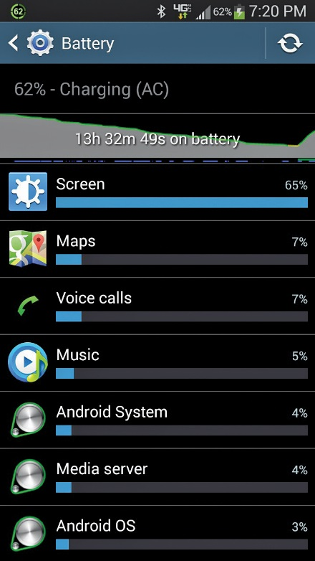
Battery Life
Figure 26.4 Battery usage for a smartphone

Slide 20
Battery Life
Wireless communication draws power
If the radio is on, but you are not actively using the communication mode, power is wasted.
Searching for signals is power-intensive.
Communicating with distant towers and base stations
Apps do more work in the background when connections are available.
Communication can be disabled.
Operating system and the app itself have settings to control when an app can send and receive data in the background along with connections it can use.

Slide 21
Battery Life
Location services
When enabled, apps query the device’s location.
Low-power methods – nearby cellular and Wi-Fi networks
High-power methods – GPS
Power drain can vary widely.
Keep location services off when not required.
Can also set per-app restrictions
Notes:
Be familiar with the factors that can reduce battery power and battery life.

Slide 22
Battery Life
Swollen battery
Main cause is overcharging when circuits designed to prevent overcharging fail.
Non-OEM chargers or batteries present additional risk.
Check manufacturer’s documentation for specific actions to take or avoid.
Subtle clues include changes in fit of device’s frame and screen, and creaking/popping sounds.
Recycle a swollen battery and replace with a known good battery.

Slide 23
Frozen System
Perform soft reset if device not responding.
Hold down power button or remove battery.
Close offending process from list of recent apps.
Uninstall a newly-installed app if that was the cause.
Reinstall or wait for updates.
Random freezing can indicate hardware issue.
Boot into special modes.
See documentation.

Slide 24
Cannot Broadcast to an External Monitor
Troubleshooting checks
Is the source correct on the external monitor?
Is the external monitor pointing at the right source?
Do you have the right adapter for your device?
Does your adapter need its own power source?
Did the HDMI recognize your device and your external monitor?
May need to reset one or both devices to give the HDMI time to see connections and set itself up

Slide 25
No Sound from Speakers
Volume may be turned down or muted through software configuration or an app.
Device has separate settings for:
Media
Call volume
Notifications
Some devices have hardware volume controls.
Speakers may be damaged or disconnected.

Slide 26
Connectivity and Data Usage Issues
Weak signal
Inside a building
Between cell towers in sparsely populated areas
Symptoms
Dropped connections
Delays
Slow transmission speeds
Indications that device is searching for signal
Notes:
In addition to signal issues, performance problems on the device itself can cause the symptoms of slow data connectivity. We’ve covered these already, but they include high utilization of resources such as CPU, RAM, and network bandwidth, and a device’s struggle to maintain a solid network connection.

Slide 27
Connectivity and Data Usage Issues
Connectivity issues with a strong signal
Overloaded network (large public gathering, emergency situation, etc.)
Carrier-enforced restrictions and limits
Exceeding data usage limits (data transmission overlimit)

Slide 28
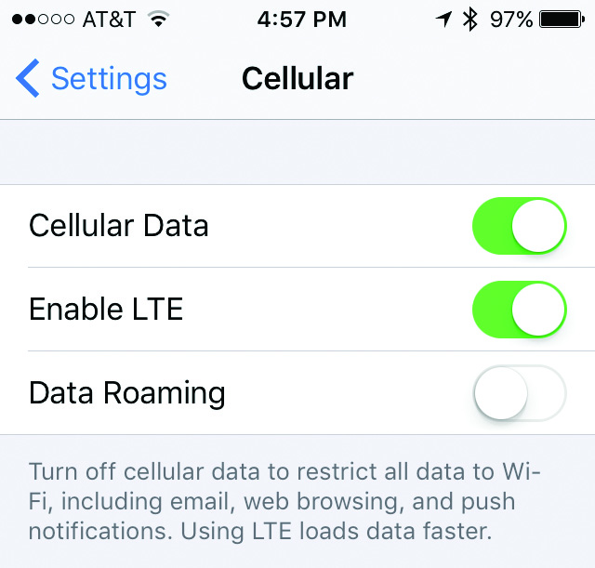
Connectivity and Data Usage Issues
Figure 26.5 Option to disable cellular data in iOS

Slide 29
GPS and Location Services Problems
Troubleshooting location problems
Make sure GPS, cellular data, and Wi-Fi are turned on and functioning properly.
Specific apps may have trouble if configured not to use location services.
Change settings if needed.
GPS does not work underground and is typically spotty indoors.
Can struggle in dense urban areas with tall buildings
Notes:
If you run into GPS error questions on the exam, remember that all apps will tell you if GPS is turned off and usually ask you if want to turn on GPS. Otherwise, before digging deeper, first consider simple issues such as whether you are in a place where you can get a good GPS signal.

Slide 30
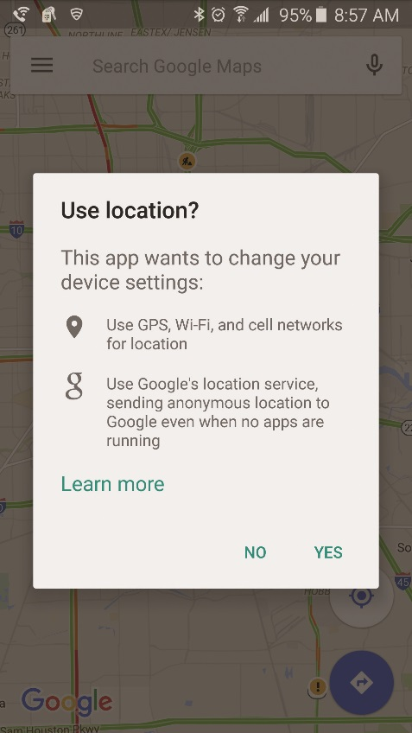
GPS and Location Services Problems
Figure 26.6 GPS prompt

Slide 31
System Lockout
Occurs when too many consecutive login attempts fail
Purpose of system lockout is to protect the device from brute-force attacks.
Configure on device itself or through mobile device management (MDM) software
Organization has ability to unlock the device if centrally controlled through MDM.
Other options: restore device from a backup or perform reset to factory default

Slide 32
Encryption Problems
Sometimes mobile devices are unable to decrypt e-mail.
E-mail client or application may not support encryption standard used.
Standards include Pretty Good Privacy (PGP) and Secure/Multipurpose Internet Mail Extensions (S/MIME)
Client will need access to decryption keys.
Keys may be exchanged automatically or manually.

Slide 33
Securing Mobile Devices
Bring your own device (BYOD)
Company policy to allow personal devices to save corporate IT dollars and keep employees happy
Most companies have a mixed environment of corporate-owned and employee-owned devices.
Cost-sharing program with company subsidizing some device fees
Extent of control of the organization and the individual
Formal policy and procedures
Notes:
The two critical issues with BYOD are personal data privacy versus protection of corporate data, and level of organizational control versus individual control.

Slide 34
Profile Security Requirements
Profile
A collection of configuration and security settings created by an administrator to apply to categories of users or devices
Created through MDM or other software
Developed based on needs of the organization
Profiles may be specific to:
Certain platforms, OSs, or devices; management groupings; or external and internal users.
Profiles give access to business intranet or VPN.
May need access to enterprise or B2B apps

Slide 35
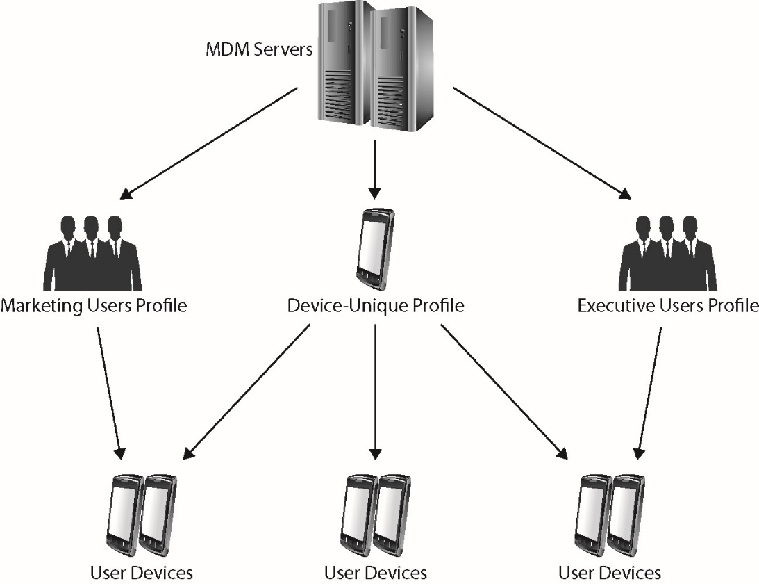
Profile Security Requirements
Figure 26.7 Applying profiles to different device and user groups

Slide 36
Preventing Physical Damage
Take these steps to prevent damage:
Get a protective cover or sleeve.
Do not put devices anywhere near liquids.
Avoid putting heavy objects on the device.
Screen protectors prevent scratches.
Waterproof cases prevent water damage.

Slide 37
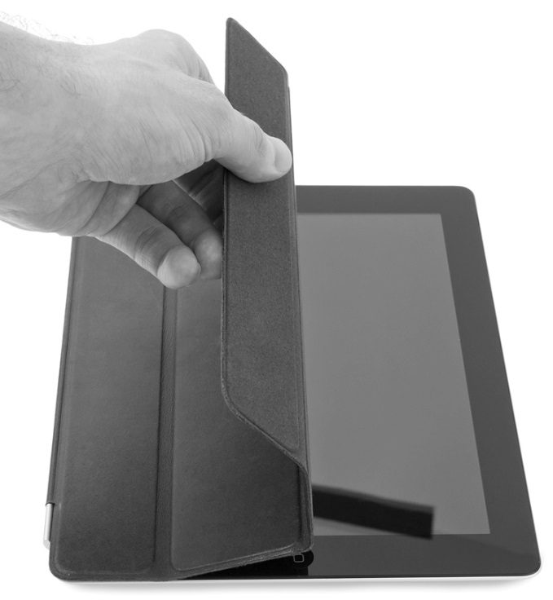
Preventing Physical Damage
Figure 26.8 Putting an Apple Smart cover on an iPad

Slide 38
Combating Malware
Tight controls on OS and apps make traditional malware infections unlikely on iOS and Windows phone devices.
Android lacks some safeguards.
Third-party solutions are available.
Manufacturer provides patching/OS updates.
The key enterprise-level anti-malware solution is delivering timely updates to devices on a routine basis.
Network access control solutions may apply.

Slide 39
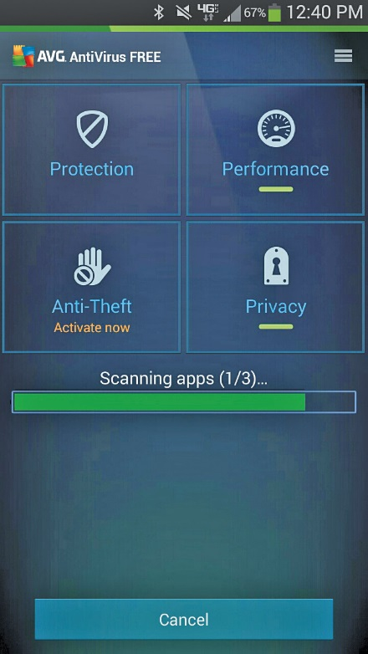
Combating Malware
Figure 26.9 Antivirus app for Android

Slide 40
Dealing with Loss
Protect your data by putting a good passcode lock or screen lock on the device.
Requires you to input a password, PIN, pattern, fingerprint, or facial recognition
Protects against data disclosure or device use in the event of theft or loss
Usually implemented through device’s Settings app
Modern iOS and Android versions encrypt contents of built-in storage.

Slide 41
Dealing with Loss
Apple, Microsoft and Google offer locator services for discovering the whereabouts of a misplaced mobile device.
Notes:
For the purposes of the CompTIA A+ 902 exam, know that fingerprint lock, face lock, swipe lock, and passcode lock are screen lock methods used to secure mobile devices.

Slide 42
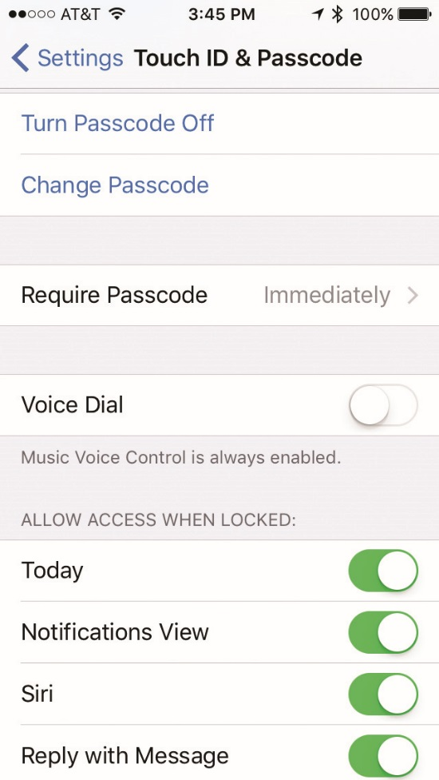
Dealing with Loss
Figure 26.10 Passcode option in Settings

Slide 43
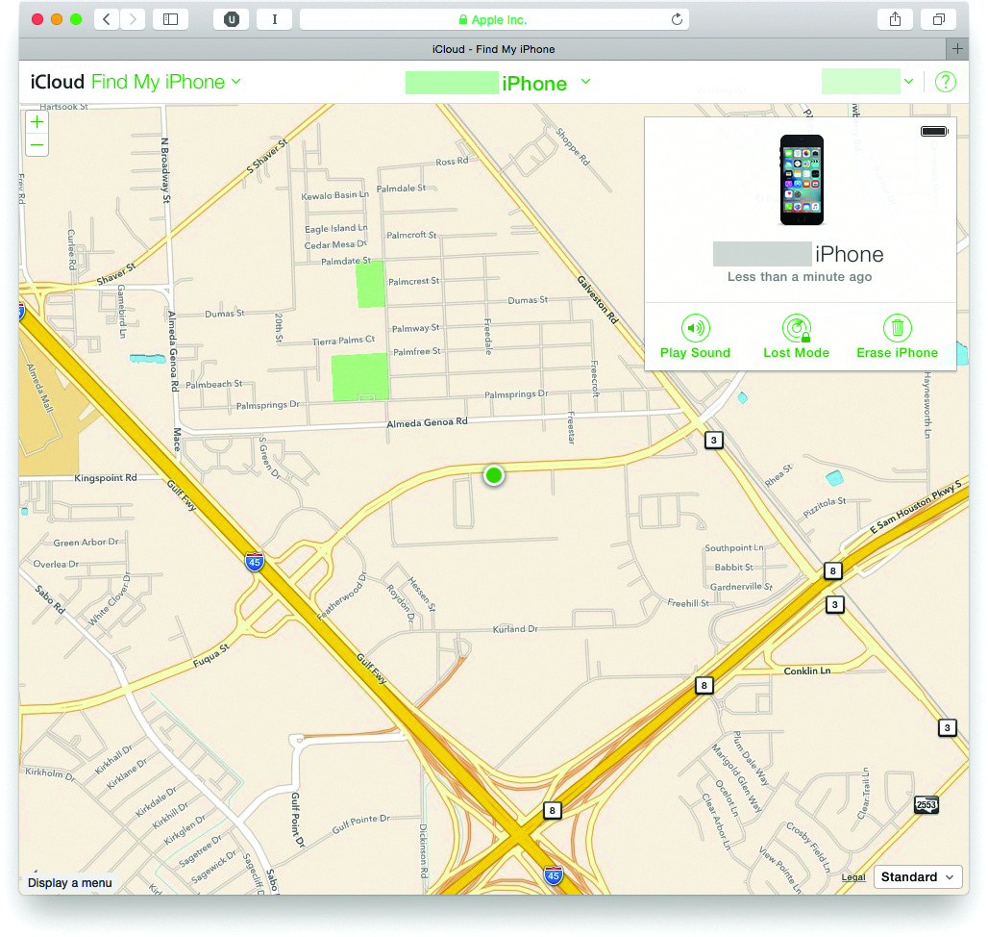
Dealing with Loss
Figure 26.11 Locating a device in iCloud

Slide 44
Recovering from Theft
Ensure you have your data backed up.
Have everything synced to local machine or remote backup application.
With Windows Phone 8.1, go into Settings and select Backup.
You can remotely wipe your mobile device to prevent data theft.

Slide 45
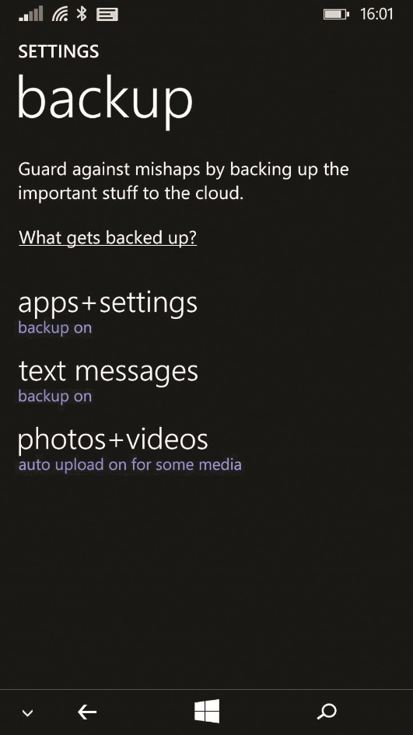
Recovering from Theft
Figure 26.12 Selecting items to get backed up

Slide 46
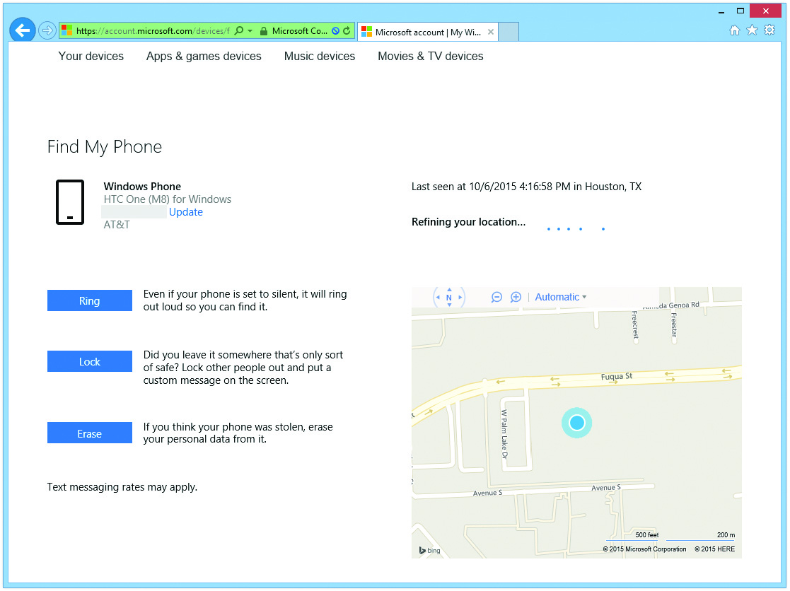
Recovering from Theft
Figure 26.13 Remote wipe

Slide 47
Securing Your Data
Multifactor authentication
More than one factor is used to authenticate the user.
Authentication factor: examples
Knowledge: username, password, or date of birth
Ownership or possession: smartcard or token
Inherence: biometric identifier, such as fingerprint or retinal pattern recognition
Location factor
Temporal factor

Slide 48
Securing Your Data
Authentication schemes
Single-factor authentication
Two-factor authentication
Multifactor authentication
Biometric authentication
Presenting smartcard to proximity badge reader and then placing finger on fingerprint reader
Laptops have included fingerprint readers for a few years
Mobile phones followed suit

Slide 49
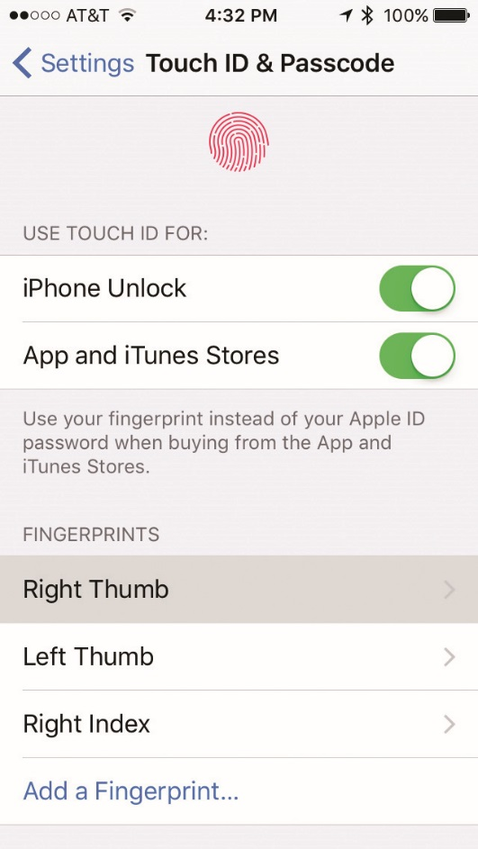
Securing Your Data
Figure 26.14 Touch ID options

Slide 50
Securing Your Data
Authenticator applications
Access to different Web sites or network-based services may require multiple sets of credentials.
Apps can act as tokens or issue temporary PINs.
Configuration is the key.
Trusted sources
Legitimate app stores from the major vendors
Apple, Google, Microsoft, and Amazon
Untrusted sources
Allowed by Android

Slide 51
Securing Your Data
Firewalls
Software firewalls on individual hosts protect from network-based threats.
Cellular networks that mobile devices use employ firewalls to protect networked devices.
Android software firewall packages offer:
Traffic filtering
Anti-malware
Basic intrusion detection
Firewalls are available as standalone and enterprise-level solutions.

Slide 52
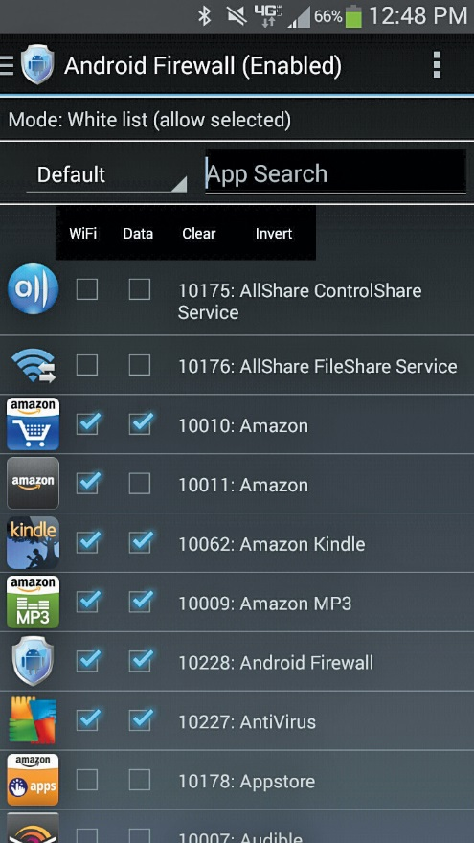
Securing Your Data
Figure 26.15 An Android firewall app

Slide 53
Mobile OS and Application Security Issues
Security is a complicated, ever-evolving topic.
Various tools are available to troubleshoot mobile OS and application security issues.
There are common risks, symptoms, and clues related to mobile security issues.

Slide 54
Troubleshooting Tools
Tools for identifying and mitigating risk of network attack
Device security settings
Make sure device won’t automatically connect to Wi-Fi or Bluetooth.
Apply settings manually or use an MDM.
User training
Users should recognize warning signs and report anything out of place.
Wi-Fi analyzer
Map out nearby networks and look for rogue WAPs.

Slide 55
Troubleshooting Tools
Cell tower analyzer
Helps identify nearby cellular signals
Estimates distance, direction, and signal strength
Use to confirm signal quality or map out access in a building
May spot illegitimate tower operating nearby

Slide 56
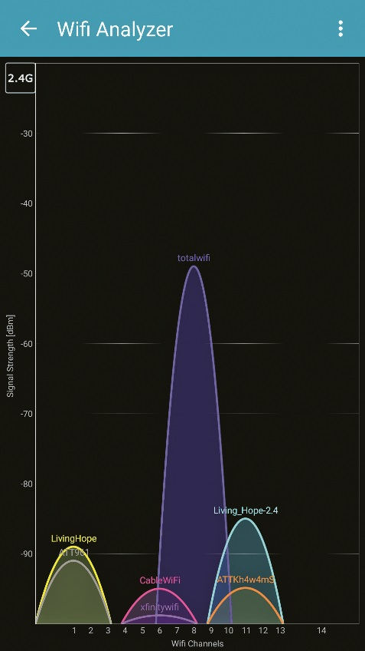
Securing Your Data
Figure 26.16 A Wi-Fi analyzer app on Android showing several SSIDs in the area

Slide 57
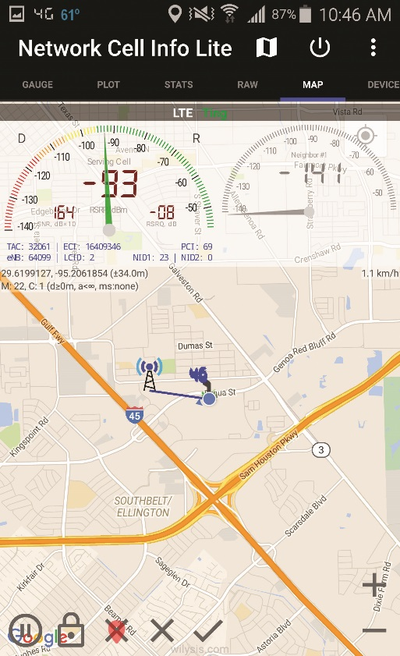
Troubleshooting Tools
Figure 26.17 My Android-based cell tower analyzer estimating the location of a cell tower

Slide 58
App Security
The “best” malware accomplishes its objective without detection.
Mobile anti-malware apps use signatures and lists to scan a device.
App scanner looks through permissions requested by installed apps to assess risk.
iOS features available through Settings app

Slide 59
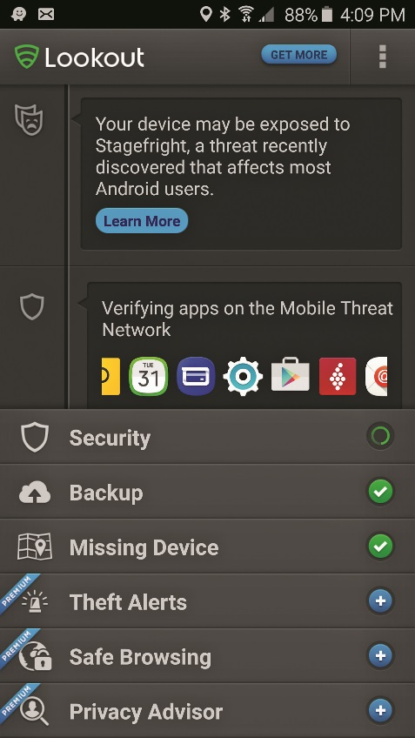
App Security
Figure 26.18 Combined anti-malware and app scanner

Slide 60
Backup and Restore
Maintain a current backup of your device.
Tools for backup and restore include:
MDM software
iTunes
Various synchronization software
Manufacturer’s user cloud storage
Troubleshooting tools can be used to pinpoint and address security issues.
Force stop, uninstalling and reinstalling apps, and a factory reset

Slide 61
Risks, Symptoms, and Clues
Unexpected resource use
Power drain and high resource utilization
Device could be recording everything it sees or copying files without your knowledge.
Slow data speeds
Device may be downloading or uploading without your knowledge.
Data transmission overlimit

Slide 62
Risks, Symptoms, and Clues
Unintended connections
Unintended network connections are uncommon but a major security issue.
Tower spoofing
Tower spoofing involves setting up equipment to spoof a carrier’s tower and infrastructure.
Equipment can be used to eavesdrop on any conversation, even if encrypted.
Sophisticated attacks can install malware on the device.

Slide 63
Risks, Symptoms, and Clues
Signal drop and weak signal
May be a clue your device is interacting with spoofed tower
In area with historically strong signal, may indicate rogue WAP
Unauthorized data access
Data leaks can occur through removable memory cards.
Should encrypt if they contain sensitive data
Configure security and privacy settings on the device.
Notes:
Portable and mobile devices present amazing opportunities for your personal information to become much less personal and a lot more public. The CompTIA A+ 902 exam calls this “leaked personal files/data,” but it could just as easily be translated as “your phone password wasn’t strong and you left the phone in a kiosk at the ski resort.” (Not that this has ever happened to me.)

Slide 64
Risks, Symptoms, and Clues
Unauthorized account access
Device should not store usernames and passwords for connecting automatically.
Lost or stolen devices could be used to access services.
Change user credentials if you suspect your device is lost or missing.

Slide 65
Risks, Symptoms, and Clues
Unauthorized root access
Jailbreaking: User installs a program on the iOS device that changes settings Apple didn’t intend users to change
Allows user to install blocked software
Enables user to unlock functionality on the device
Rooting: Similar procedure to grant the user full administrative access to lower-level functionality of Android device
Unlocking: Official process that applies to Windows Phone devices for app developers

Slide 66
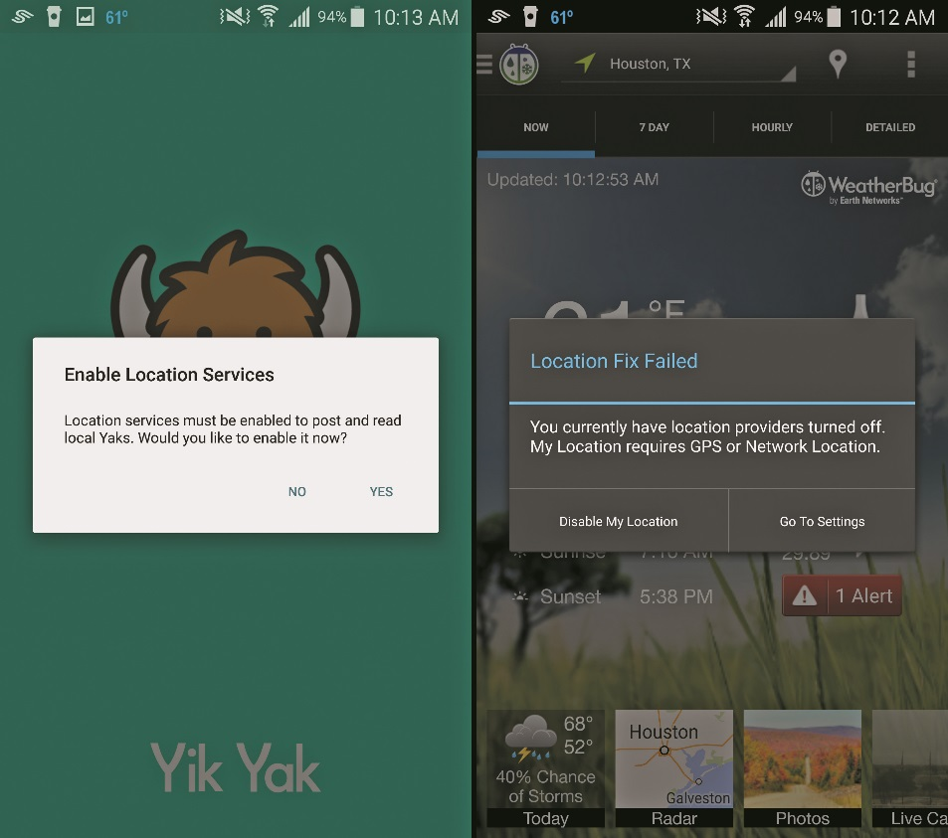
Risks, Symptoms, and Clues
Figure 26.19 Two Android apps prompting the user to enable location services

Slide 67
Risks, Symptoms, and Clues
Unauthorized location tracking
A user’s location may be sent to third parties.
Turn off GPS function or location services until needed.
Geofencing
Organization can track when employees enter and leave a predefined area.

Slide 68
Risks, Symptoms, and Clues
Unauthorized camera and microphone activation
Enable attacker to effectively spy on anyone nearby
Restrict camera and microphone permissions in apps or operating systems
Notes:
Some of the most sophisticated attacks using methods discussed in the earlier “Unintended Connections” section can reportedly cause a device to appear to power down, while still leaving its microphone active. Attacks of this quality may be unavoidable until carriers and device makers secure their networks and devices against them, but you can still be on the lookout for strange behavior.

Slide 69
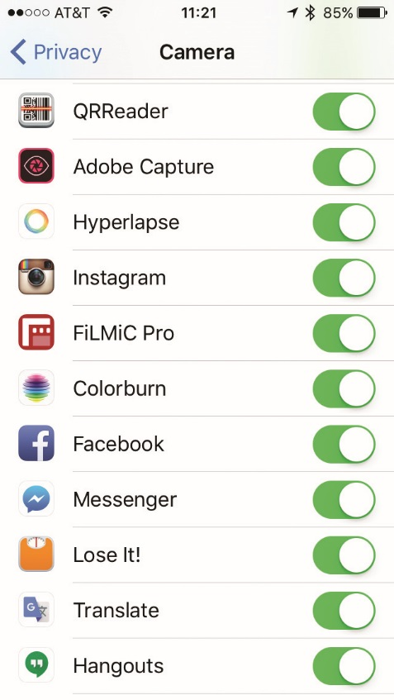
Risks, Symptoms, and Clues
Figure 26.20 Apps with permission to access my iPhone’s camera

Slide 70


Slide 71
Summary
Troubleshoot common mobile device and application issues
Explain basic mobile device security
Describe typical mobile OS and application security issues

Slide 72


